Slide 1



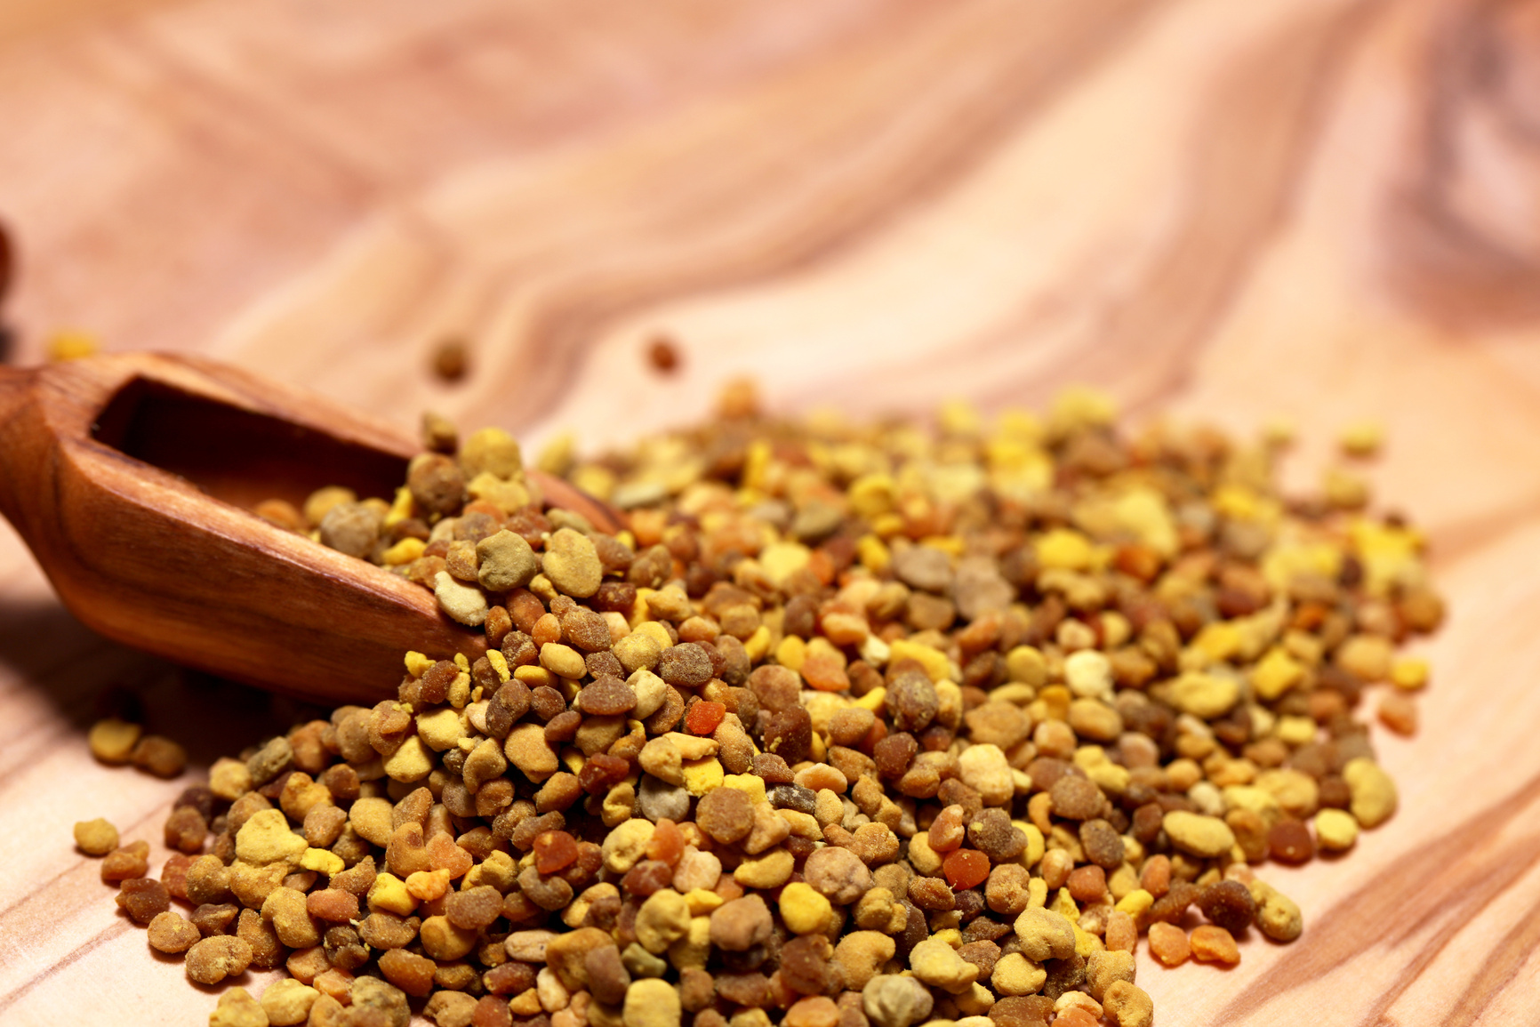

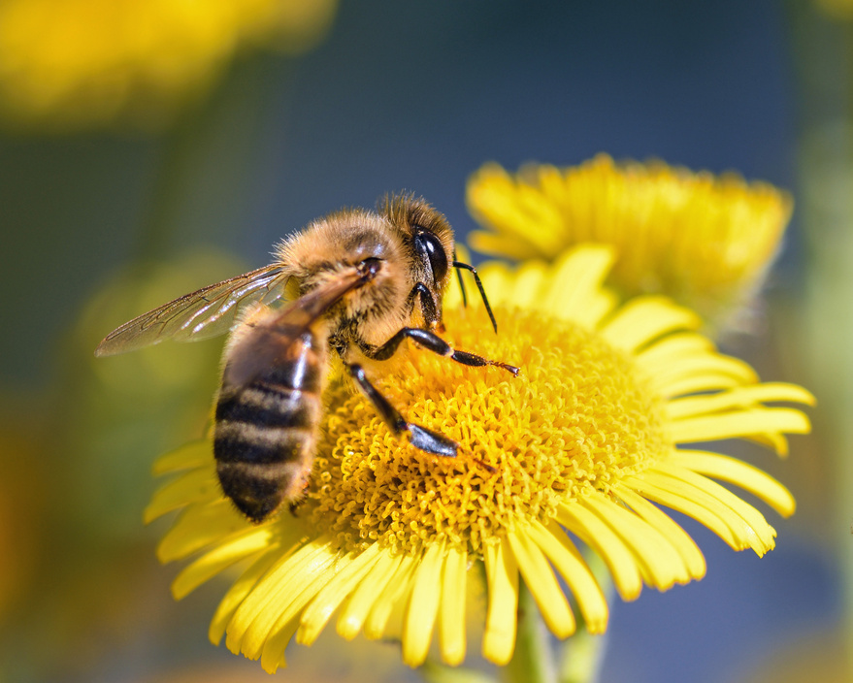
Determination of Trace Metals in Canadian Bee Pollen by ICP-MS
Connor Johnson and Megan Martin Supervisor: Dr. Kingsley Donkor

Slide 2
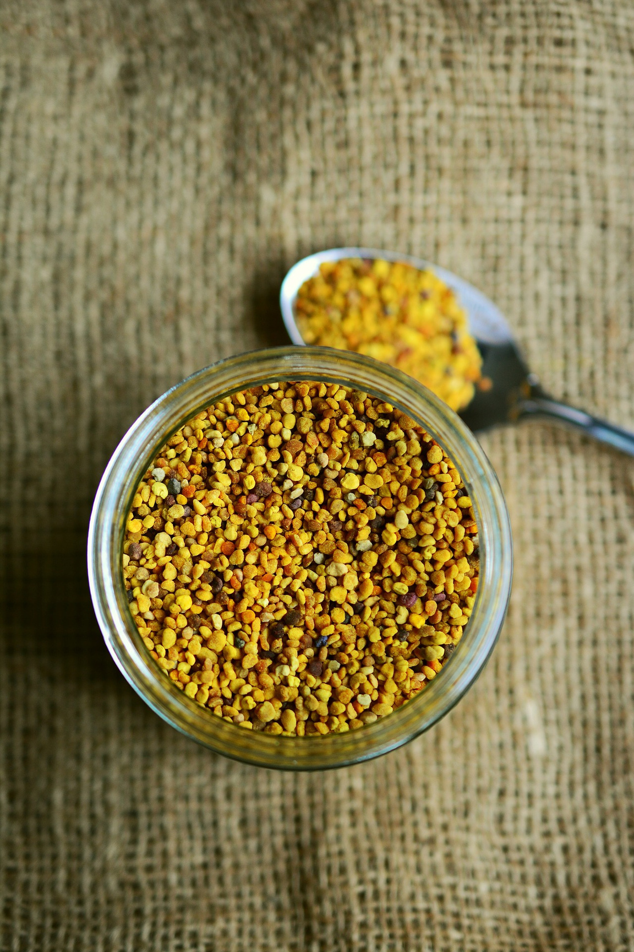
Bee Pollen
The New Natural ‘Superfood’
Bee pollen, a nutrient-rich treasure collected by pollinators, also serves as a natural superfood for humans, offering a boost to health and vitality.
Bee pollen has been noted for its potential health benefits:
  Lowers cholesterol levels
  Anti-inflammatory effects
  Immune system (blocks the release of histamine)
  Reduces depression
(WebMD, 2022)

Slide 3


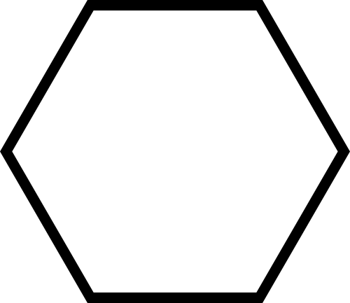
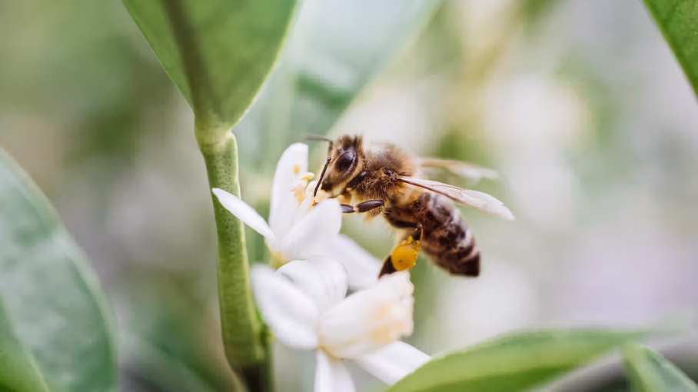

Bee Pollen Research
Trace metals have been detected in bee pollen in Poland, Turkey and Italy (Roman, 2009; Bay et al., 2021; Flamminii et al., 2024).
Some known causes:
  Environmental pollution
  Flying area within industrial zones
Serves as a visible indicator of how pollution can impact pollinators.
Westend61, Bee collecting pollen on a citrus plant, Getty images, 2017.

Slide 4

Question:
Are there concerning levels of metals present in Canadian bee pollen?

Slide 5
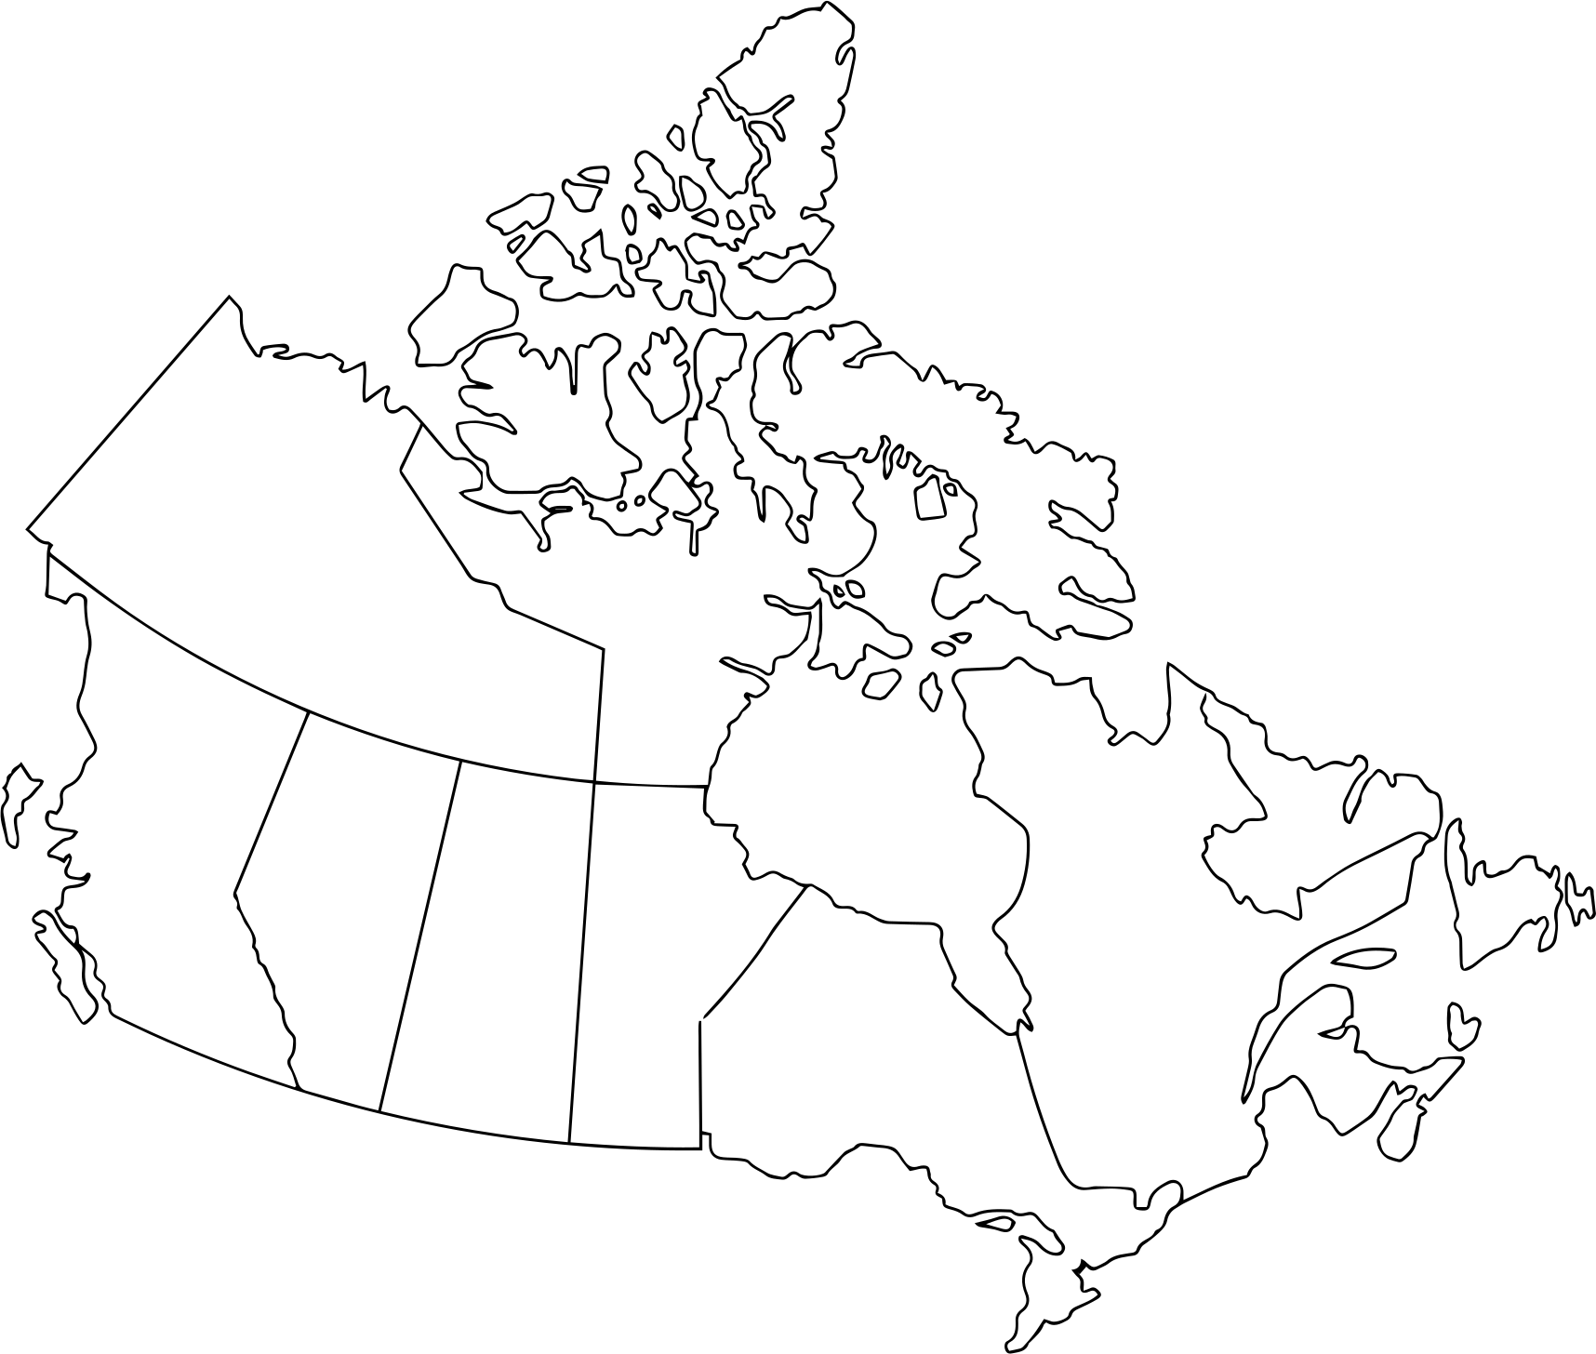



Samples

Slide 6
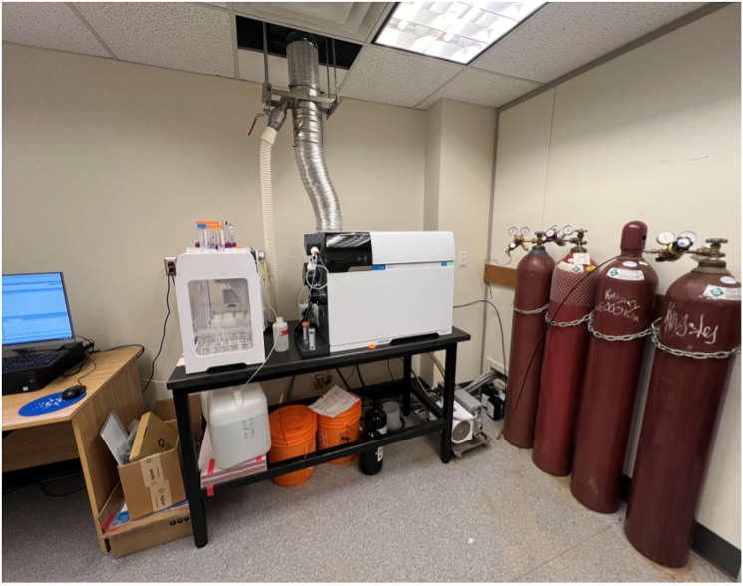
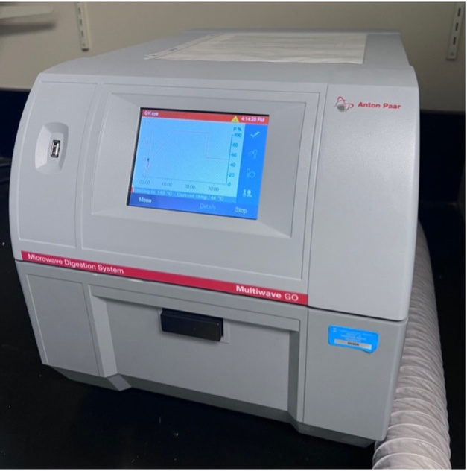
Instrumentation and Parameters
Anton Paar Multiwave GO:
Initial Temperature (°C) | 0
Final Temperature (°C) | 180
Ramp Time | 10:00 minutes
Hold Time | 15:00 minutes
Agilent 7900 ICP-MS
Anton Paar Multiwave GO
Nebulizer | MicroMist
Spray Chamber | Quartz, double pass
RF Power | 1550 W
Ar Flow Rate (L/min) | 15
Auxiliary Gas Flow Rate (L/min) | 0.9
Nebulizer Gas Flow Rate (L/min) | 1.0
Sample Uptake Rate (rps) | 0.1
Number of Replicates | 3
Integration Time | 0.3-1.0
Auto Sampler | SPS 4
Probe Depth | 150mm
Internal Standards | Sc, Ge, Rh, In, Tb, Lu, and Bi
Agilent 7900 ICP-MS
45
72
103
115
159
175
209

Slide 7
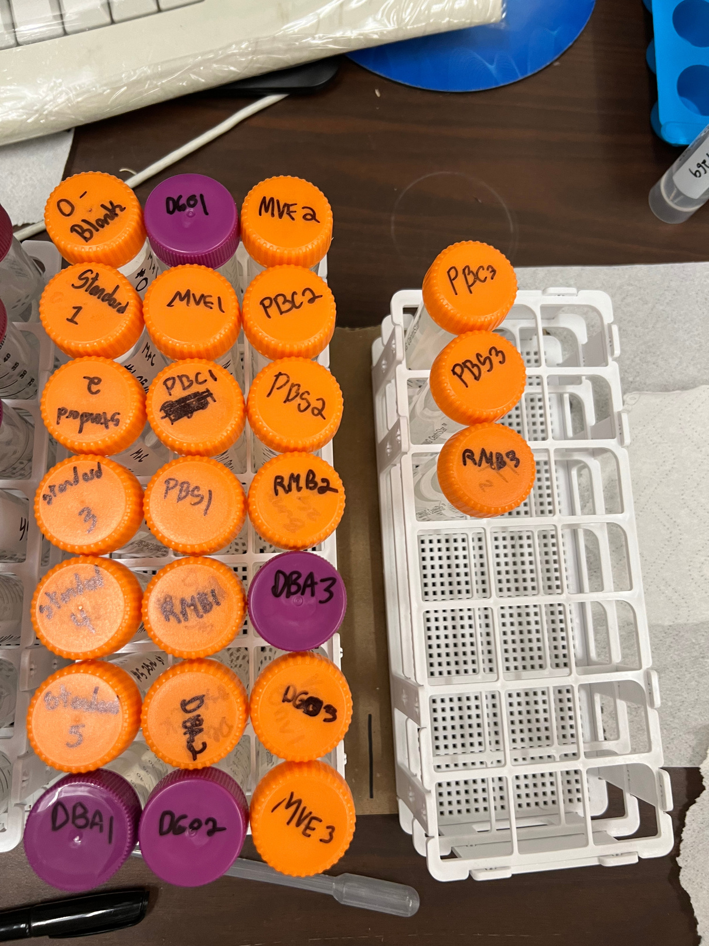
Experimental Procedure
2.
Microwave Digestion
1.
Sample Preparation
3.
Filter
~0.5g of bee pollen crushed and added to microwave digestion tubes with 15 mL of nitric acid
Digestion tubes were placed in the rotor and then into the microwave
The samples were filtered to remove any remaining particulates
5.
Standard Preparation
4.
Dilute
6.
Analysis
Samples were diluted with 2% nitric acid in 50-mL Falcon tubes
Standards were prepared using an environmental calibration standard with 2% nitric acid in a 50-mL Falcon tube
Samples were analyzed with the ICP-MS

Slide 8
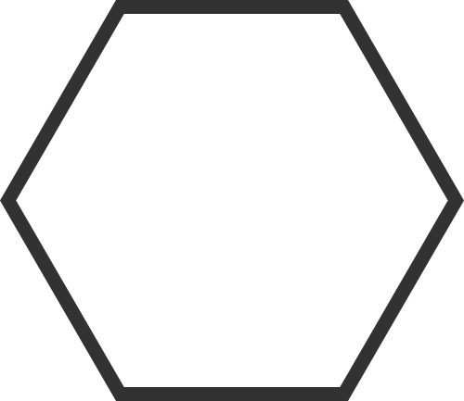
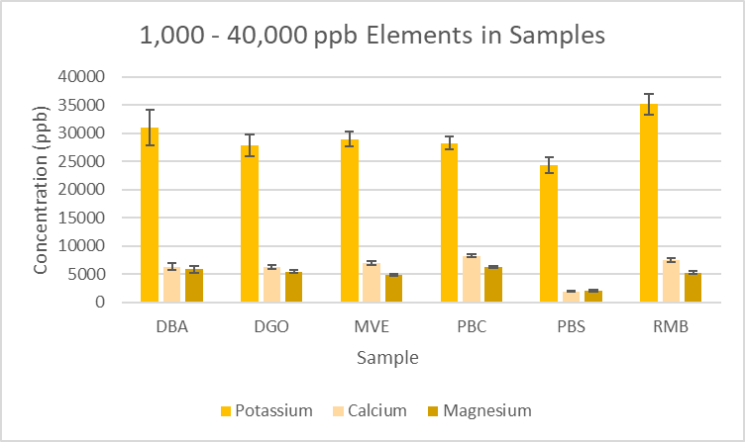
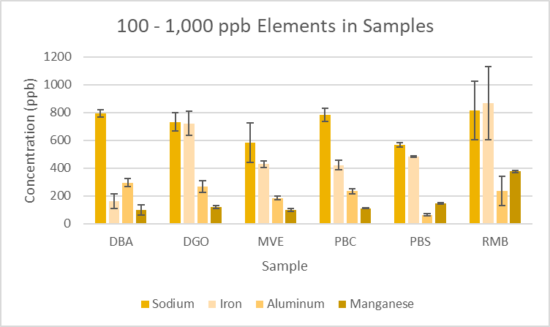
Results
Figure 1. Concentrations of elements in bee pollen between 1,000-40,000 ppb.
Figure 2. Concentrations of elements in bee pollen between 100-1,000 ppb.

Slide 9
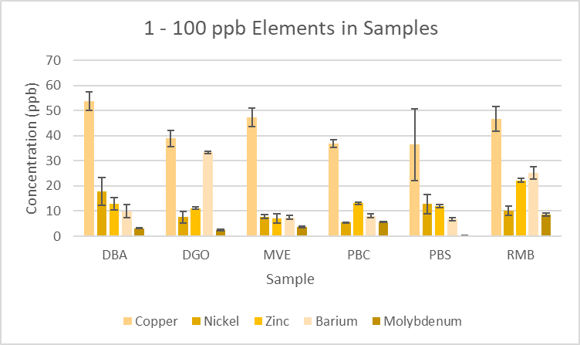
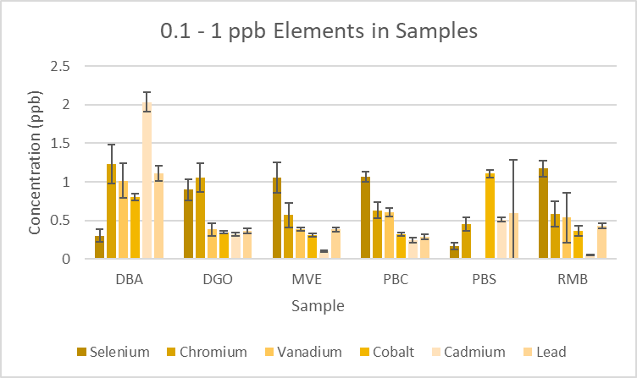
Results cont.
Figure 3. Concentrations of elements in bee pollen between 1-100 ppb.
Figure 4. Concentrations of elements in bee pollen between 0.1-1 ppb.

Slide 10
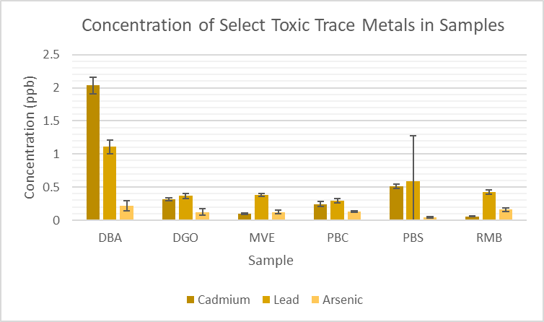
Results cont.
Figure 5. Concentrations of cadmium, lead and arsenic in bee pollen between 0.01-2 ppb.

Slide 11
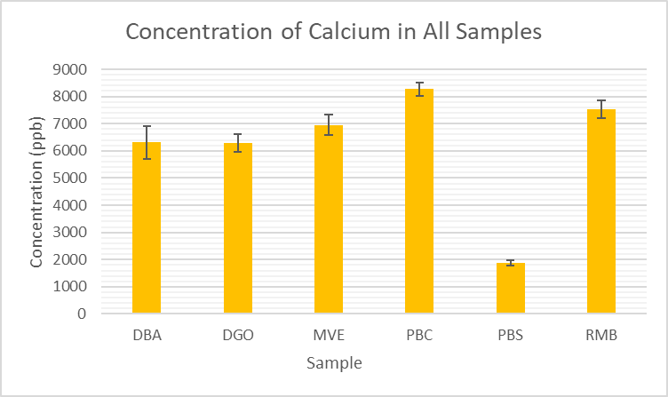
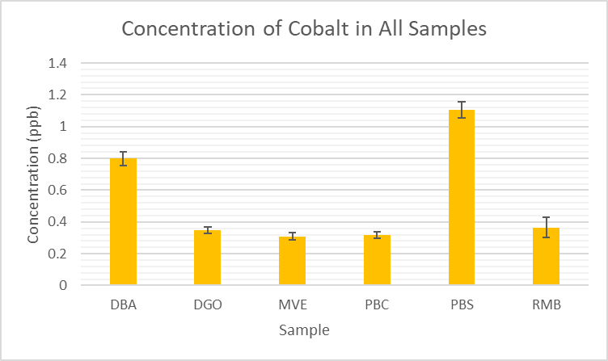
Results cont.
Unique trend:
Figure 6. Concentration of calcium in all bee pollen samples.
Figure 7. Concentration of cobalt in all bee pollen samples.

Slide 12
&
Conclusion
Future Work
Trace metal concentrations were identified, yet they fell within the permissible limits set by Health Canada.
  Mercury analysis
  Flight areas
  Test different sample prep method
  Longitudinal study
Monitoring of bee pollen is recommended to determine changes in environmental conditions.

Slide 13




Acknowledgments
Dr. Kingsley Donkor for being my supervisor and a remarkable instructor.
Megan Martin for being a great project partner and supporter.
The Canada Foundation for Innovation for the purchase of the ICP-MS.
Natural Sciences and Engineering Research Council of Canada (NSERC) for providing funding for the research supplies and argon gas for this project.
Thompson Rivers University Chemistry Department.

Slide 14
Questions?
Thank you for your time.
If you have any questions feel free to connect with me.
johnsonc201@mytru.ca

Slide 15
Citations
WebMD. Health Benefits of Bee Pollen. https://www.webmd.com/diet/health-benefits-bee-pollen (accessed 2024-09-02)
Flamminii, F.; Consalvo, A.; Cichelli, A.; Chiaudani, A. Assessing Mineral Content and Heavy Metal Exposure in Abruzzo Honey and Bee Pollen from Different Anthropic Areas. Foods 2024, 13 (12), 1930. DOI: 10.3390/foods13121930.
Roman, A. Concentration of Chosen Trace Elements of Toxic Properties in Bee Pollen Loads. Polish J. Environ. Stud. 2009, 18 (2), 265–272.
Bay, V.; Topal, E.; Çakıcı, N.; Yıldızdal, İ.; Tosunoğlu, A. Palynological Analyses, Chemical and Mineral Composition of Some Honeybee Pollen Pellets. U. Arı. D.-U. Bee J. 2021, 21 (2), 187–189.
Westend61, Bee collecting pollen on a citrus plant, Getty Images, https://www.gettyimages.ca/detail/photo/bee-collecting-pollen-on-a-citrus-plant-royalty-free-image/758305561 (accessed September 2, 2024).

