Slide 1
The Hunt for New Banana Flavouring: The 60-Year Mystery
By Connor Johnson
Supervisors: Dr. Jessica Allingham, Dr. Naowarat Cheeptham, and Dr. Kingsley Donkor
CHBI4990 Honours
Honours Update
February 6, 2025

Slide 2
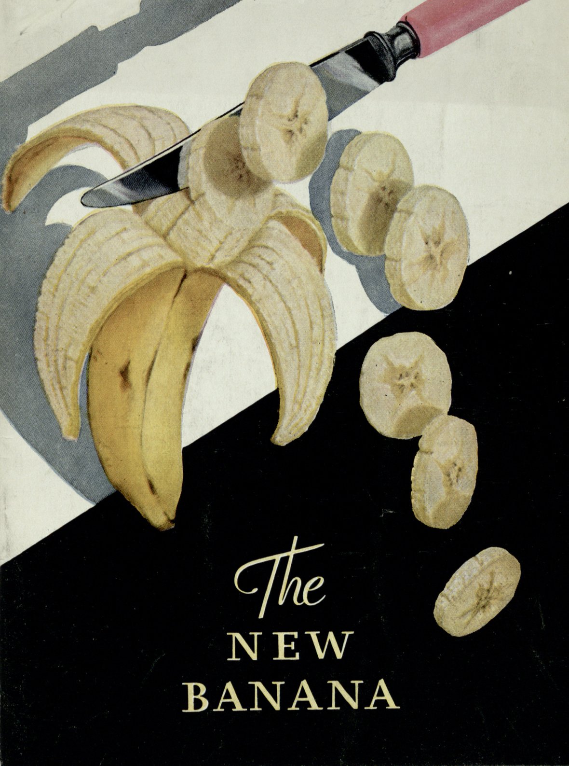
Background
02
1860s - Banana flavouring was first synthesized
1876 - Bananas became popular at the Philadelphia Centennial
1960 - Effective extinction of the Gros Michel banana, Introduction of the current Cavendish Cultivar
Banana flavouring never changed to match the Cavendish
2025 - Risk of extinction of the Cavendish
Notes:
1876 philadelphia centennial:
telephone first introduced at the centennial
Cavendish makes up 99% of the total globally exported bananas
risk of death by Panama disease - what killed Gros Michel

Slide 3
03
Extraction of volatile organic compounds (VOCs) in Cavendish and Gros Michel bananas
Objectives
Analysis of VOCs in Cavendish and Gros Michel bananas and to be compared with “Watkins Banana Extract with Other Natural Flavours” by gas chromatography-mass spectrometry (GC-MS)
What we want to achieve
Comparison of VOC profiles for a new banana flavouring

Slide 4
Methods
04
Extraction
Analysis
of VOCs in Bananas
of VOCs in Bananas
Test different methods of extraction to analyze the banana flavouring:
Steam distillation
CO₂ Extraction
Organic solvent extraction
Supercritical fluid extraction
Sonication
Method development for GC-MS
Analysis of fruit extracts, banana flavouring, and an isoamyl acetate standard with GC-MS
Identification of each compound through NIST mass spectral database
Look at fruit variation

Slide 5
Steam Distillation
05
Banana fruit
Banana peel
Notes:
Worked well at extracting VOCs
Smelled very ripe
Potential loss of desired analytes

Slide 6
CO₂ Extraction
06
Desiccated bananas
Banana slice
Banana mush
Banana peel
Notes:
No sample preparation method worked (freeze drying, dehydrating, NO2 chilling, peel, mush)
Low VOC content in banana

Slide 7
Analysis
07

Slide 8
Results
Isoamyl acetate standard and Cavendish
08
Isoamyl acetate
Cavendish Banana

Slide 9
Results
Banana Flavouring and Cavendish
09
Watkins Banana Extract with Other Natural Flavours
Cavendish Banana
Notes:
"The Banana Extract With Other Natural Flavors is a proprietary blend of several different natural flavors, including extractives of banana. For this product Watkins purchases and blends the flavors together at our facility. While we do perform extractions for some of our other products, we are not performing any extractions on bananas."

Slide 10
Conclusion
10
Extraction
Analysis
Further work
UNCOVERED KEY PROBLEMS
NOTICEABLE DIFFERENCE
THE GROS MICHEL
PRECISION
EXTRACTIONS
Heat introduction to sample will cause unwanted ripening, leading to unwanted results
CO₂ extraction may work, but need larger scale (like supercritical fluid extraction)
Possible to use solvent extraction, like organic solvent extraction
Very noticeable difference between spectra for the flavouring and cavendish
Simplistic mixture in flavouring due to cost-benefit analysis?
Notes:
"The Banana Extract With Other Natural Flavors is a proprietary blend of several different natural flavors, including extractives of banana. For this product Watkins purchases and blends the flavors together at our facility. While we do perform extractions for some of our other products, we are not performing any extractions on bananas."

Slide 11
Acknowledgements
11
Thanks to Jess, Ann, and Kingsley for all the unwavering support on this project
Thanks to Trent Hammer and Michelle Boham for all the help troubleshooting the GC-MS and the guidance on instrument operation
Thanks to Jessica Whitehouse for helping with the GC-MS
Thanks to Thompson Rivers University’s Undergraduate Research Experience Award Program for funding the project and allowing us to purchase an irresponsible amount of rare bananas

Slide 12
Thank you
Any Questions?
CHBI4990 Honours
Honours Update
February 6, 2025

